Slide 1
Diplodocus Team
KC Oh
Alfonso Camero
Marie Prosper

Slide 2
Project Description
Analyzing Airbnb listing within the US for 2020
Number of listing vs. cities
Price vs. cities
Availability vs. City
Average number of reviews
Average Airbnb price of listings from states
Average reviews of listings from states
Dataset
Airbnb
Csv file: https://www.kaggle.com/kritikseth/us-airbnb-open-data
API: https://www.google.com/amp/s/rapidapi.com/blog/airbnb-api-python/amp/

Slide 3
Project Questions
Inspiration
Can we predict the price of each house in different regions?
Can we describe a region using the names of listings in that region?
What can we learn about different regions from the data?
Based on different factors is it possible to recommend a title to the host for his/her listing?
Can we estimate the popularity of a listing based on given features?
What are we trying to solve? Independent/Dependent variables
What cities offer the most availability?
What areas offer the best prices?
How does population affect price and availability?
What are the most established market for Airbnb based on customer review?

Slide 4
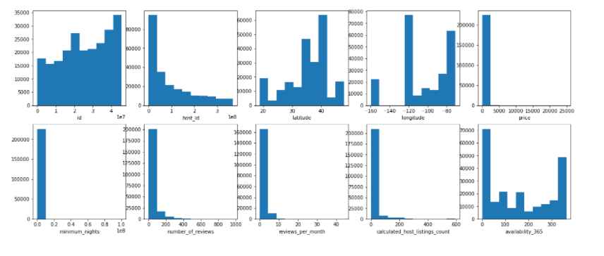
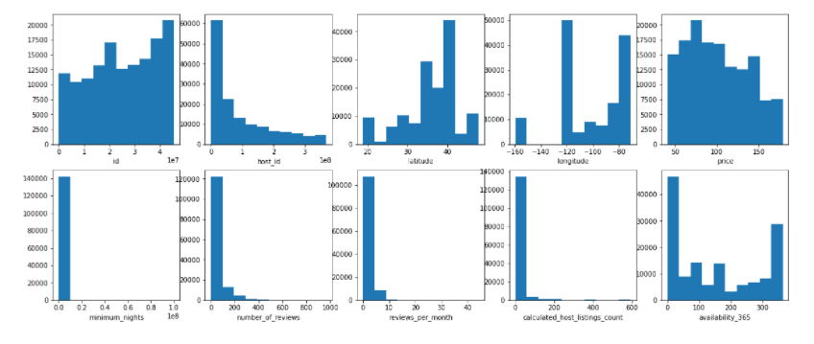
Histogram for price prediction
Before removing outliers
After removing outliers

Slide 5
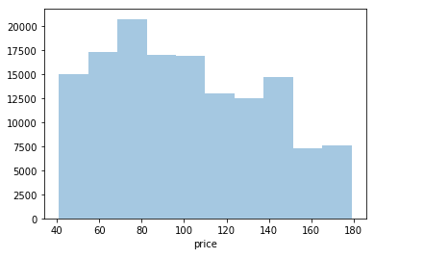

Outlier removal
Removing the outliers from the price column.
As most of the listings have price less than 200 and more than 40 we remove the other listings for better predictions when trying to predict the price per night for the listings.
sns.distplot(df[(df['price']<180) & (df['price']>40)]['price'],kde=False,bins=10)

Slide 6
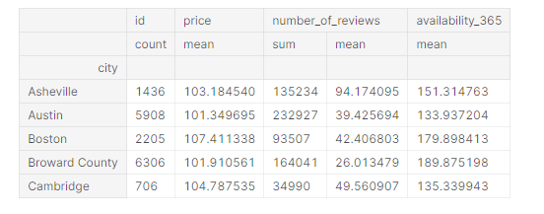
Price prediction
Now the price values are much more evenly distributed and hence we can get fair predictions from our model

Slide 7
Breakdown of Tasks (still working on this)
Marie Prosper
Project manager, Histogram
KC Oh
Bar Graphs
Alfonso Camero
Maps, API

